Slide 1


DATABASE DESIGN AND
IMPLEMENTATION
Task 6
Group 18

Slide 2

Content
Introduction
01
02
Characteristics of NoSQL
Database Design Process
03
04
ER Diagram
Implementation
05
06
Conclusion

Slide 3
Introduction
Databases are foundational to most modern applications, enabling efficient storage, retrieval, and management of data. A well-designed database not only ensures data integrity and performance but also simplifies application development and maintenance.
1

Slide 4
What is a database?
A database is an organized collection of structured information, typically stored electronically in a computer system.
For our disaster management mobile application, we used NoSQL database is suitable for use in disaster management mobile applications due to several of its characteristics that aligns well with the unique requirements and challenges of our application
1

Slide 5




Characteristics
Flexibility in handling diverse data types
High availability and reliability
Geospatial capabilities
Handling unstructured and semi-structured data
2

Slide 6
Database Design Process
Database design is a structured process that involves several stages, from understanding the requirements to creating a functional database schema. A well-designed database ensures data integrity, supports efficient query execution, and can scale as the application grows.
1

Slide 7
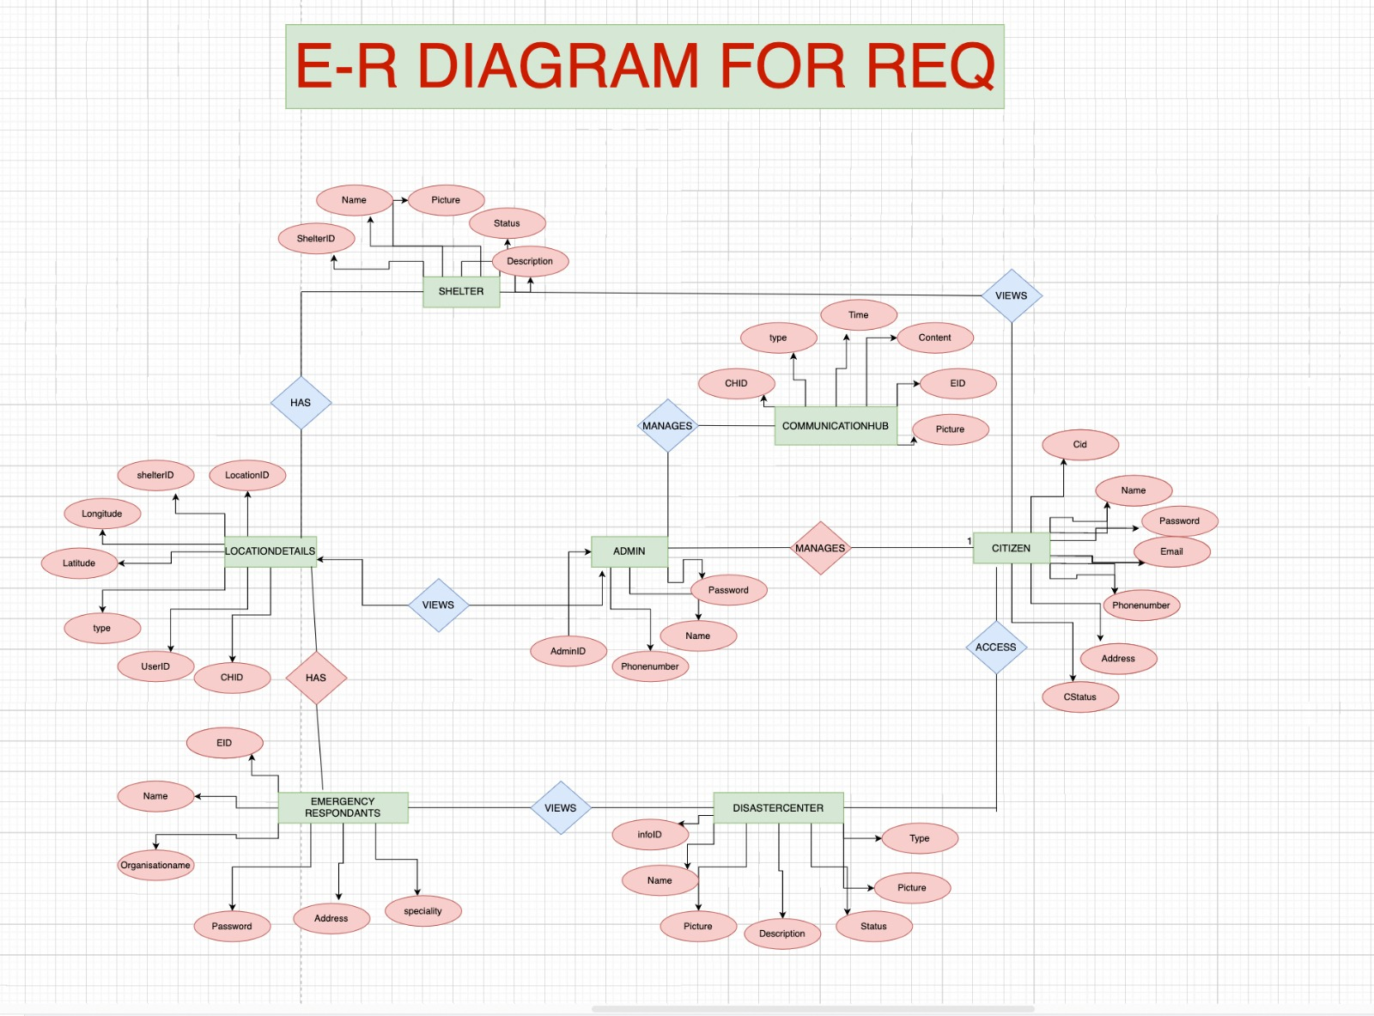
ER Diagram
1

Slide 8
Implementation
It involves translating the logical database design into a physical database schema that can be executed on a specific DBM platform
1
Connecting Database
2
Creating Models, Routes and Controllers
3
4
Create Database

Slide 9
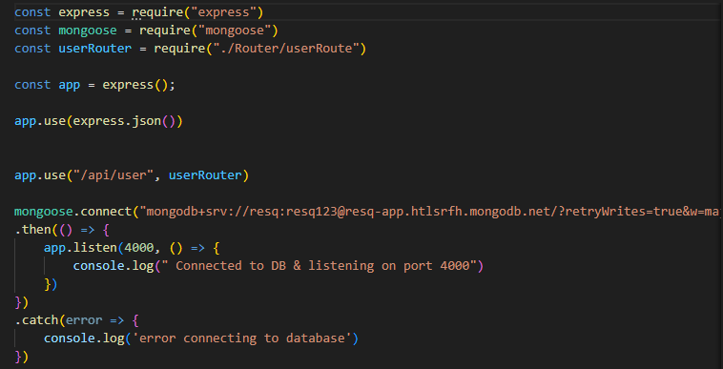
Connecting our database to the backend
The connection of MongoDB database using Mongoose, a popular Object Data Modeling (ODM) library for MongoDB and Node.js providing a higher-level API for interacting with MongoDB.
5

Slide 10
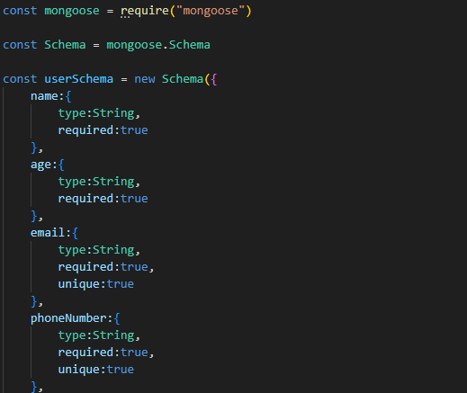
Creating models
Creating models in MongoDB using Mongoose involves defining schemas and then creating models based on those schemas.
5

Slide 11
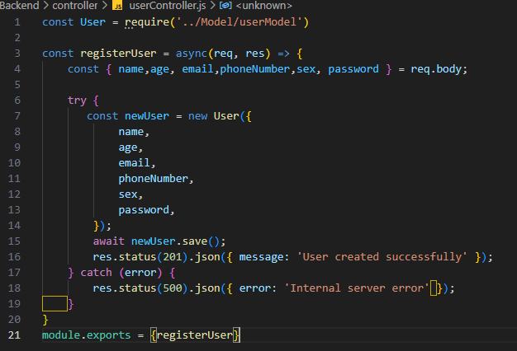
Creating Controller
Controllers are functions which govern the logic of the application. In this case, the controllers were created for each model in order to populate data into the database.
5

Slide 12
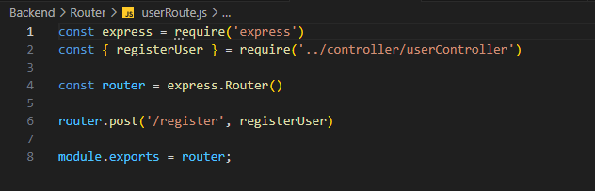
Creating Routers
Routers help in defining how an application responds to client requests to various endpoints, typically corresponding to different database operations
5

Slide 13
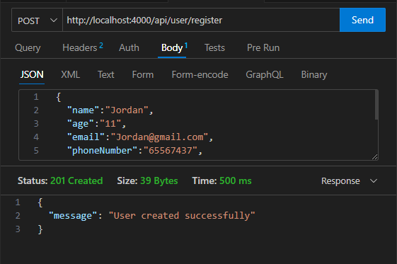
Populating a Database
Using the Thunder Client tool, which is a REST API client extension for Visual Studio Code, we populated the router by testing and interacting with our API endpoints.
5

Slide 14
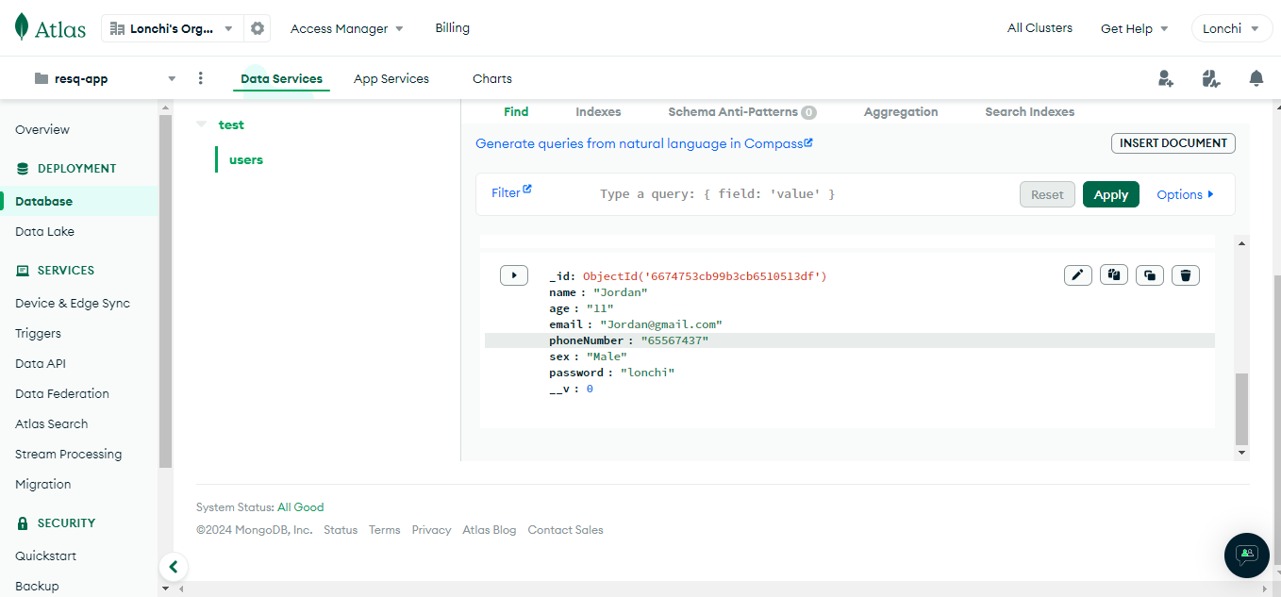
Database Creation
5

Slide 15
CONCLUSION
The database design and implementation for a disaster management mobile application form the backbone of a resilient and effective system. By prioritizing data integrity, scalability, security, and user accessibility, the database supports the critical mission of saving lives and mitigating the impact of disasters.
16

Slide 16
Thank you

